Slide 1

Matrix Manufacturing & Retail Report
Grace Cheuk

Slide 2

Aims & Objectives
Report overall performance of the company
Understand the root cause of decline
Make an informed decision around future spending on marketing campaigns
Understand the relationships between:
customer purchases,
product categories,
Revenue
Understand how time of year affects customer sales
Notes:
The overall aim of this project is to develop a report that can determine the overall performance of the company. This report will bring together data from a core set of performance indicators, into a single analysis.
understand the root cause of this decline and make an informed decision around their future spend on marketing campaigns.
Understand the relationships between customer purchases, product categories and revenue, to enable more sales, an increase in revenue per sale and to improve the quantity of products purchased per sale.
Understand the role that the time of year plays to a customer, as this insight would likely improve sales significantly.

Slide 3

Background Information
The organisation has recently experienced a decline in its profit margin, despite a huge increase to their marketing budget.
The business has been witnessing a quarterly 20% sales increase, which enabled them to introduce new products every other month.
The incremental pattern in sales and expansion has declined drastically over recent months and the board believe that by identifying the products generating fewer sales, would allow for a marketing programme to be developed leading to an increase in sales.
Notes:
The overall aim of this project is to develop a report that can determine the overall performance of the company. This report will bring together data from a core set of performance indicators, into a single analysis.
The organisation has recently experienced a decline in its profit margin, despite a huge increase to their marketing budget. The boards aim is to understand the root cause of this decline and make an informed decision around their future spend on marketing campaigns.
The business has been witnessing a quarterly 20% sales increase, which enabled them to introduce new products every other month.
The incremental pattern in sales and expansion has declined drastically over recent months and the board believe that by identifying the products generating fewer sales, would allow for a marketing programme to be developed leading to an increase in sales.
This initial piece of work will lead to a more detailed application of data analytics across specific business areas and / or to the implementation of targeted marketing actions and new product development.
This report will help to encourage the board that intelligent and creative use of data analysis can give the organisation an advantage. It will also help them to understand the marketing strategy for each product, whilst considering the time of year at which sales are highest.
Your manager would like to understand the relationships between customer purchases, product categories and revenue, to enable more sales, an increase in revenue per sale and to improve the quantity of products purchased per sale.
They want to understand the role that the time of year plays to a customer, as this insight would likely improve sales significantly.
The key challenge facing the board is that decisions will need to be made regarding upcoming, coinciding marketing campaigns and if these should be postponed temporarily or permanently.

Slide 4

Report Structure
Regional sales by category
Profitability year-on-year
Profitability this year against last year's figures
Product subcategory breakdown
Organisational recommendations

Slide 5
1. Regional sales by category

Slide 6
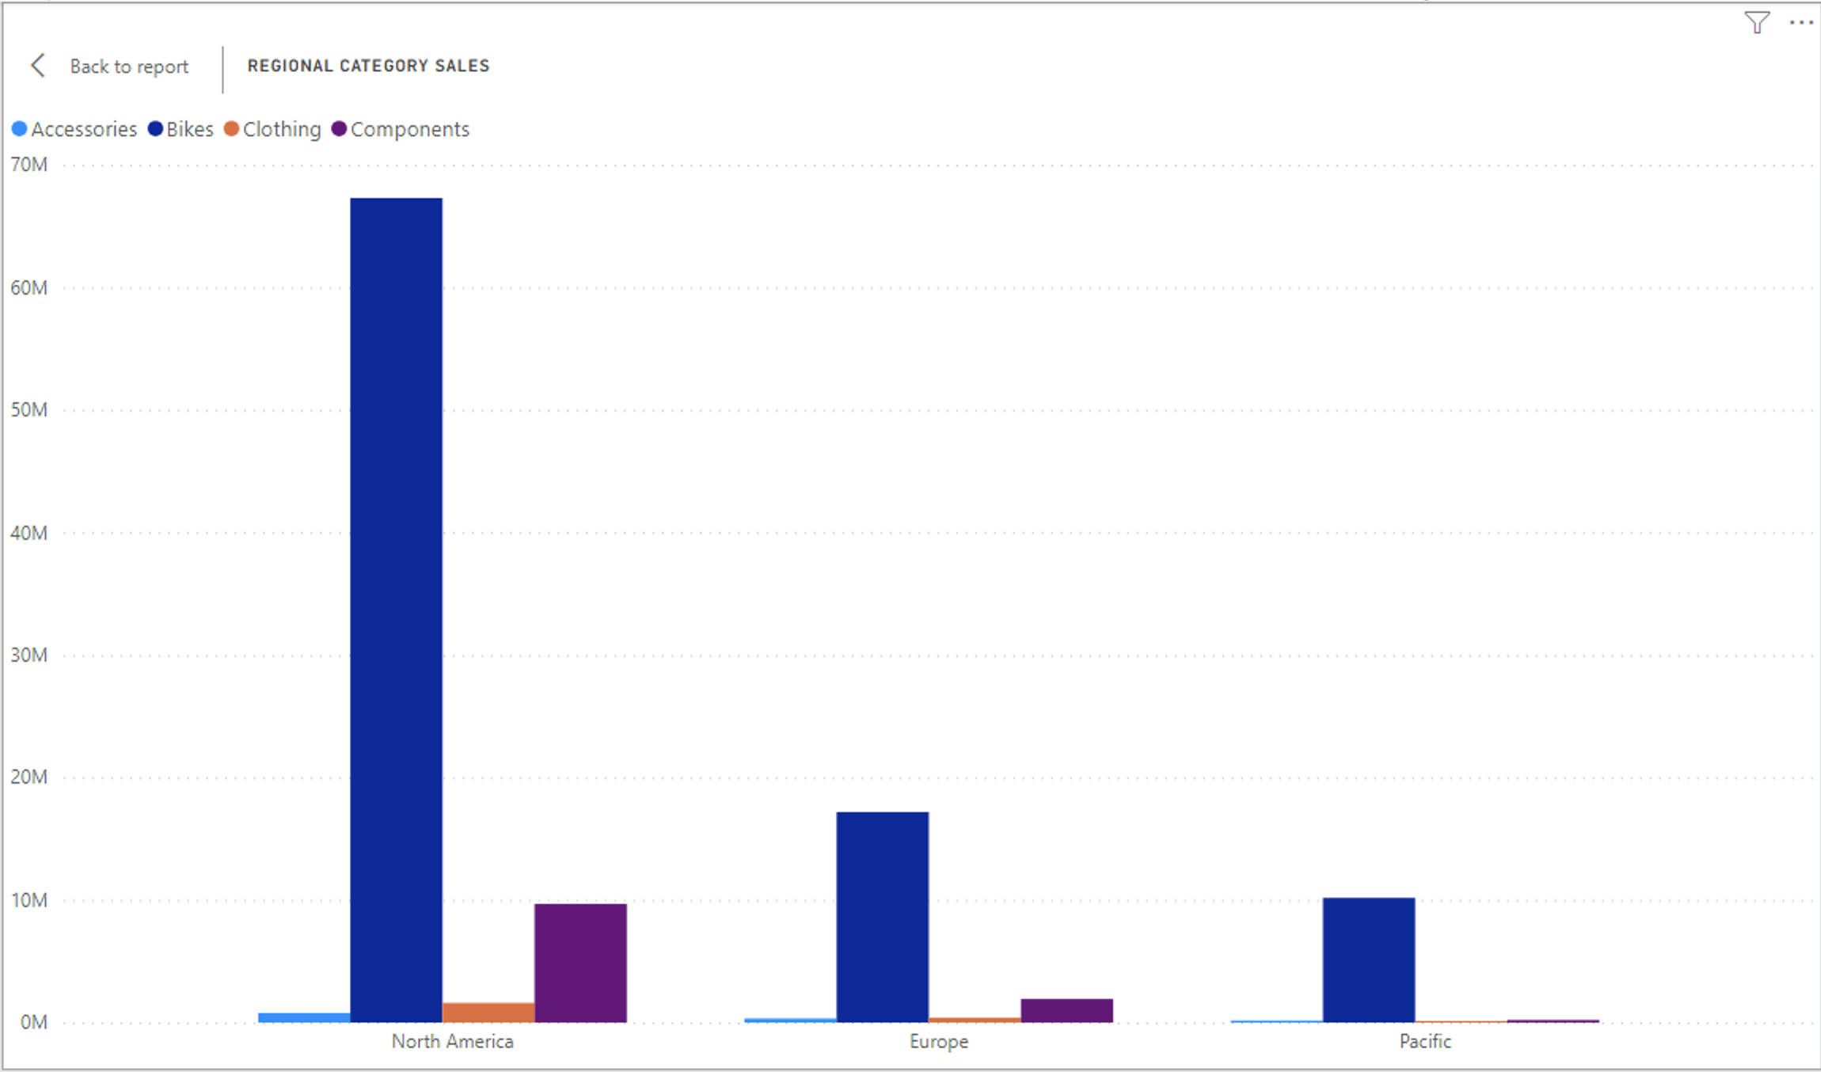
Regionally sales are overall higher in North America
Categorically, sales of bikes are highest, components second

Slide 7
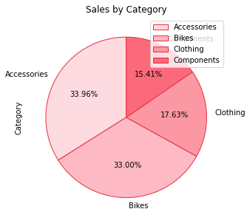
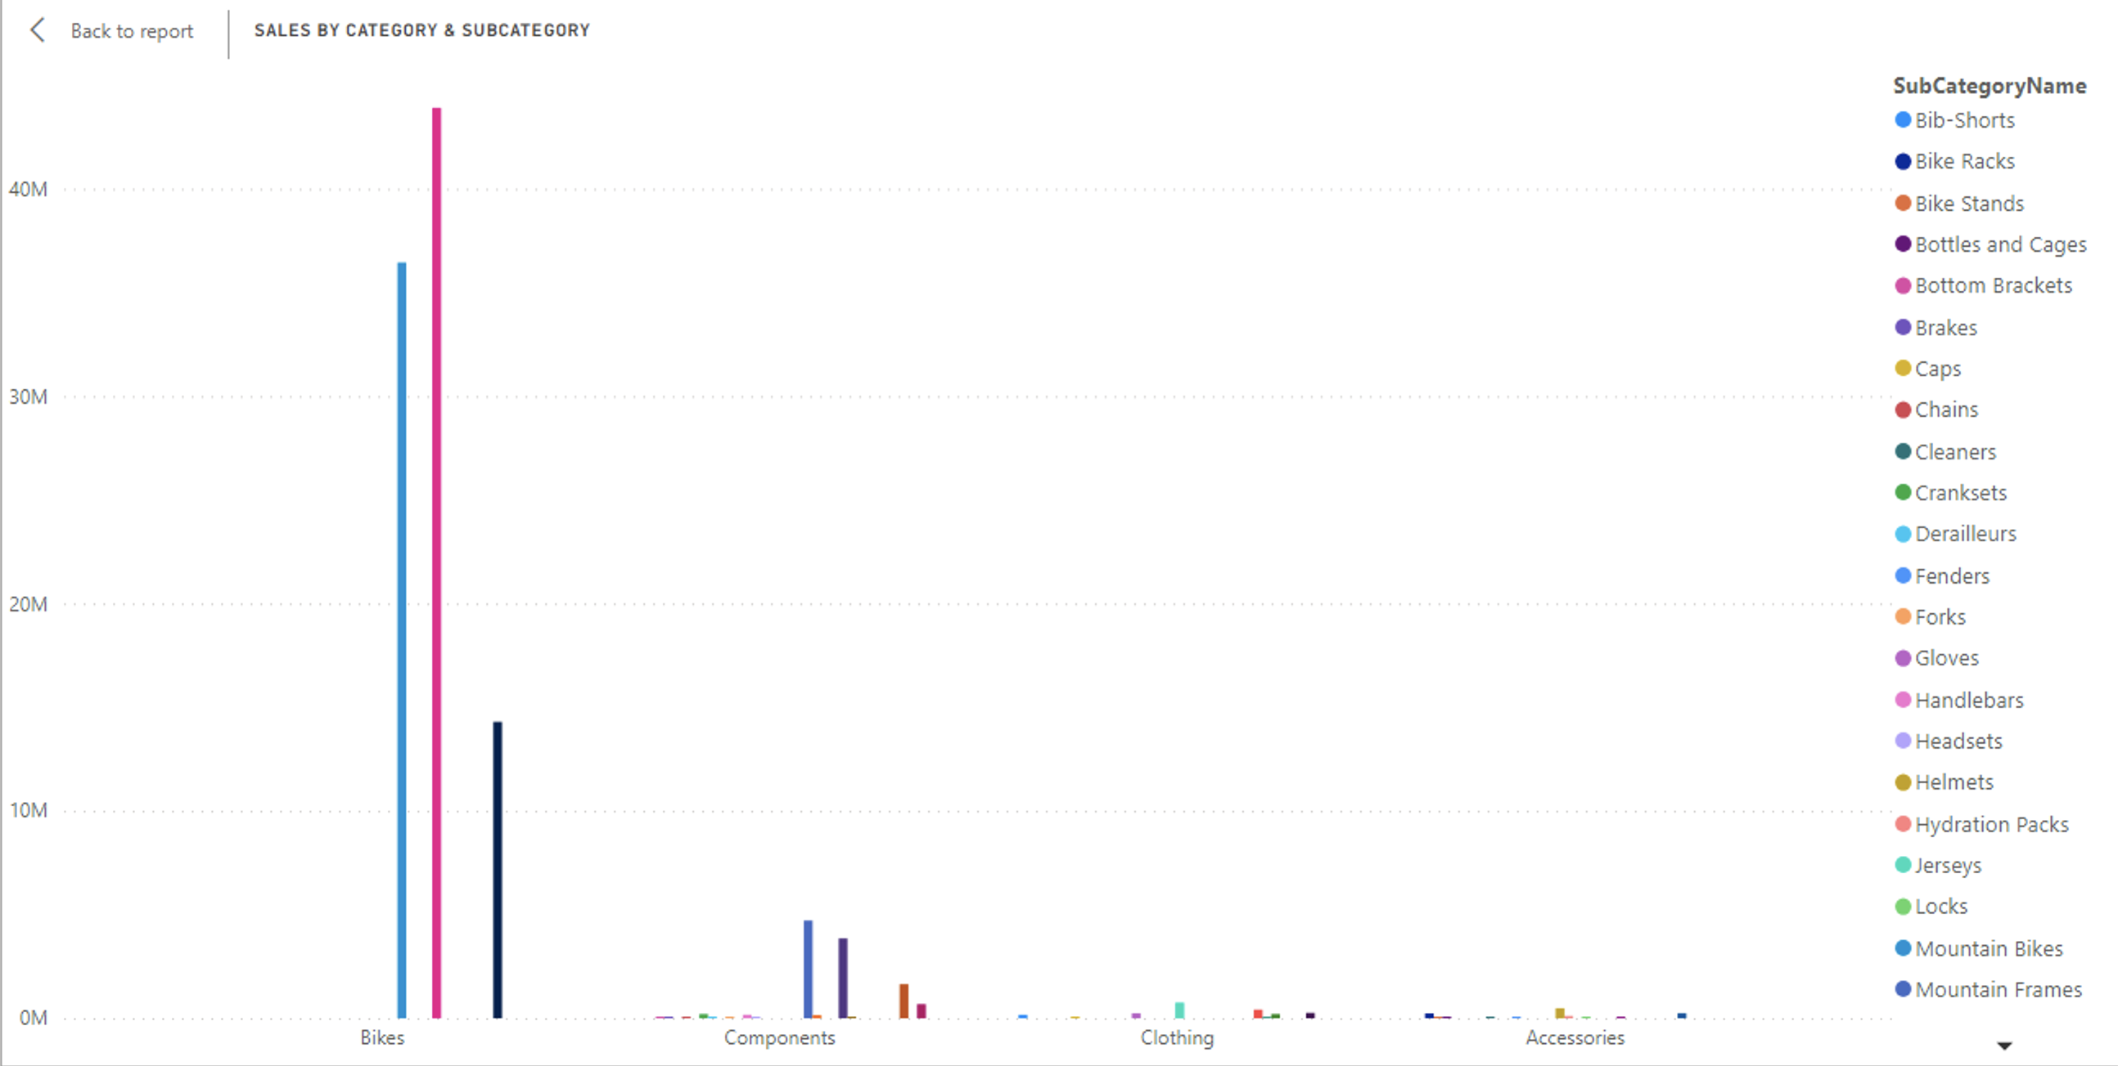
Accessories and Bikes sold the most quantities of items Whilst the bikes: road bikes and mountain bikes brought the most revenue in sales respective

Slide 8
2. Profitability year-on-year

Slide 9
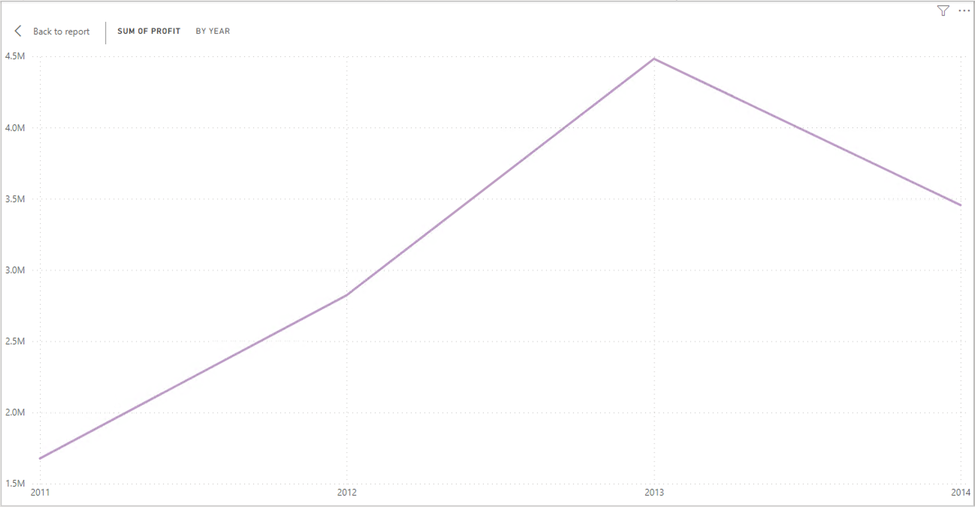
Steady profit incline 2011-2013
Drop in profits from 2013-2014

Slide 10
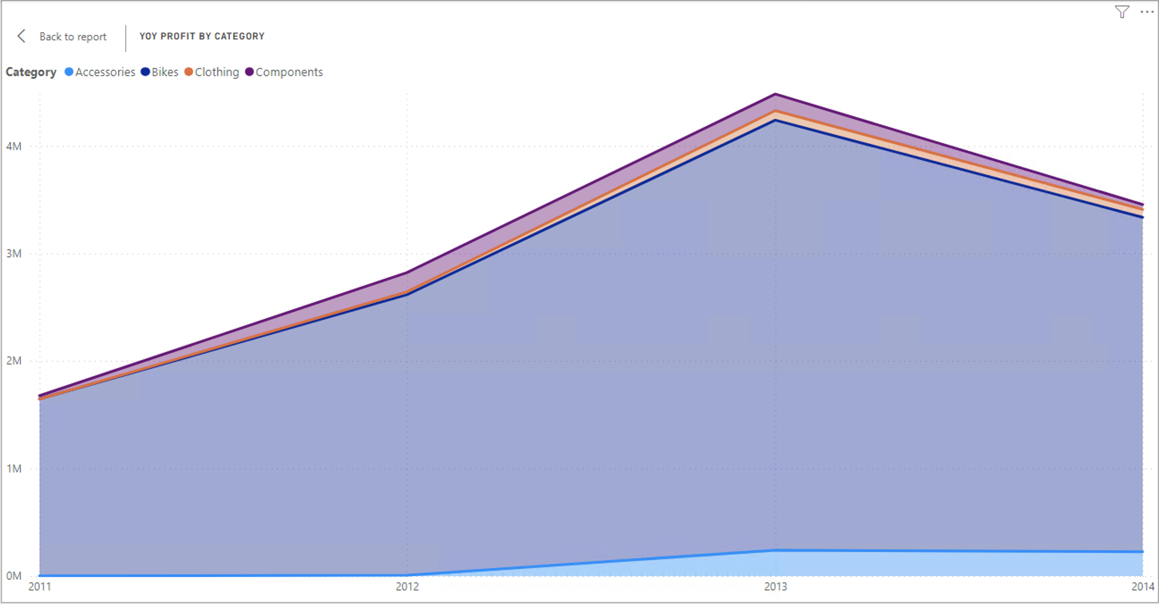
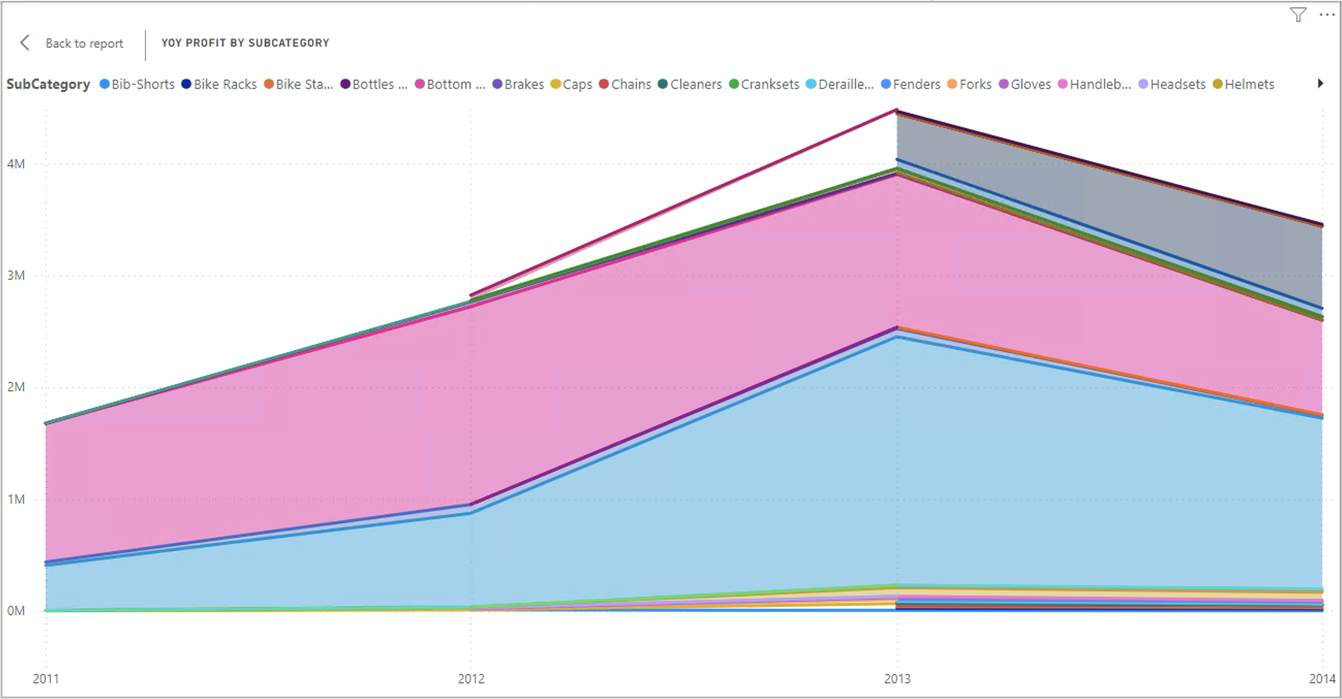
Accessories made least profit in comparison with other categories. A decline in profit is seen 2013-2014 Introduction of new Subcategory products in 2013 could be the cause of the profit decline

Slide 11
3. Previous Year Comparison

Slide 12
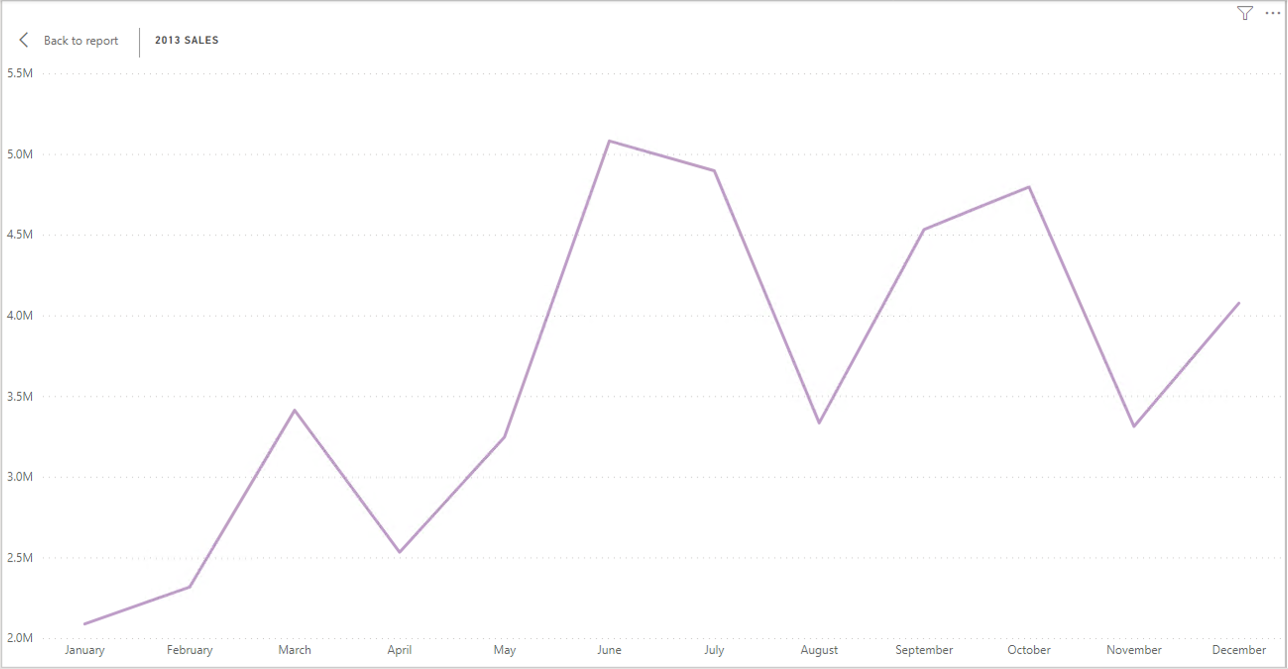
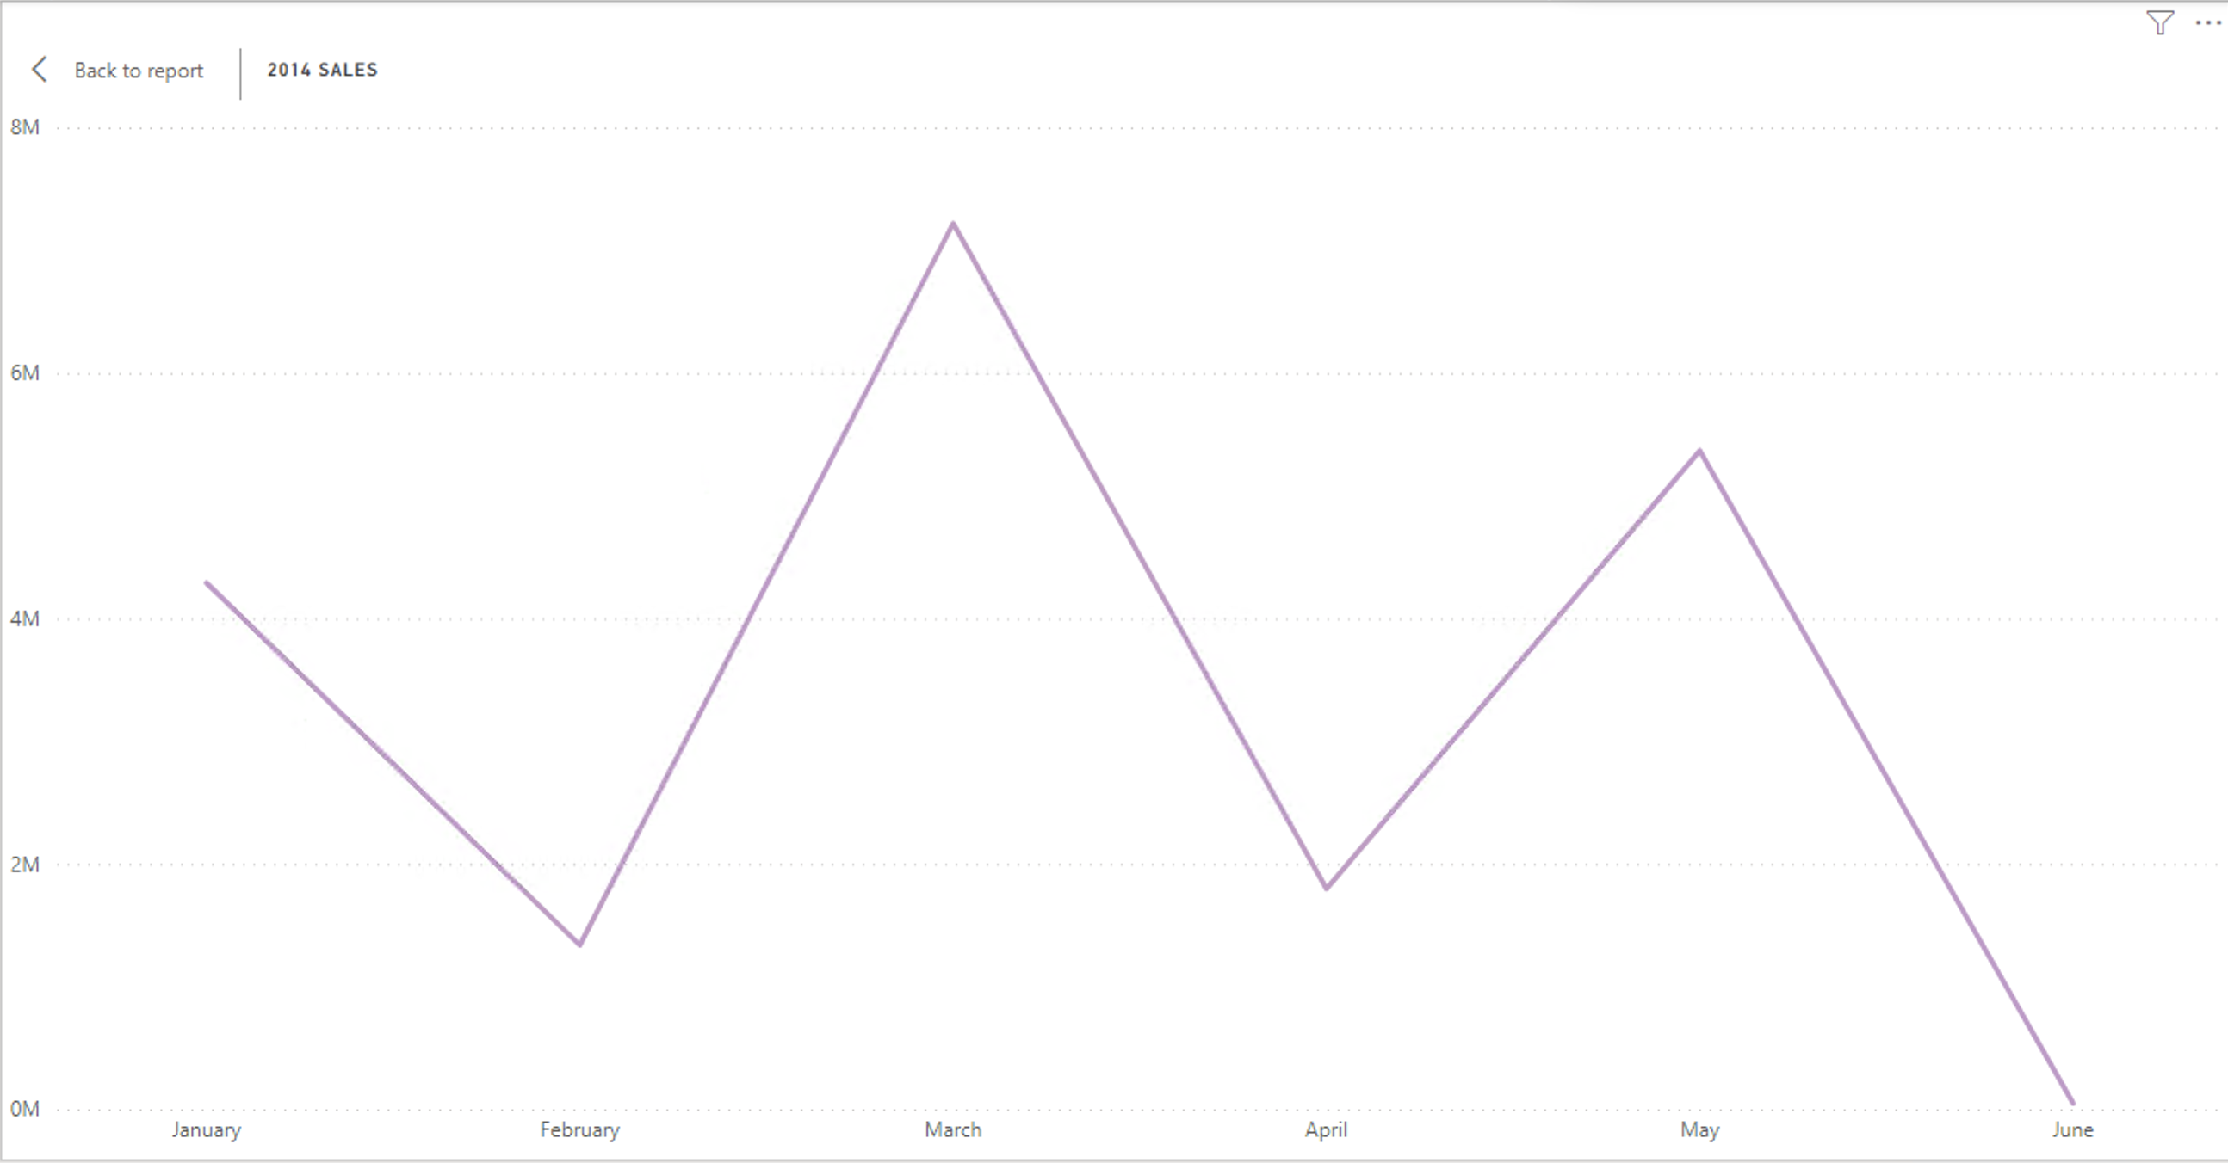
Sales 2013 v 2014
2014 (6 months) shows constant fluctuation in sales monthly
Each profit incline is followed by a month of decline – suggesting customer spending habits
2013 (12 months) shows constant fluctuation in sales
Positive correlation
Pattern seen is 2 months of incline followed by one month of decline

Slide 13
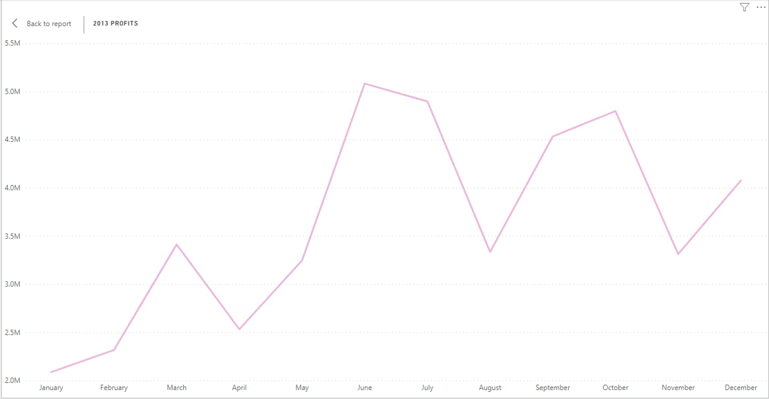
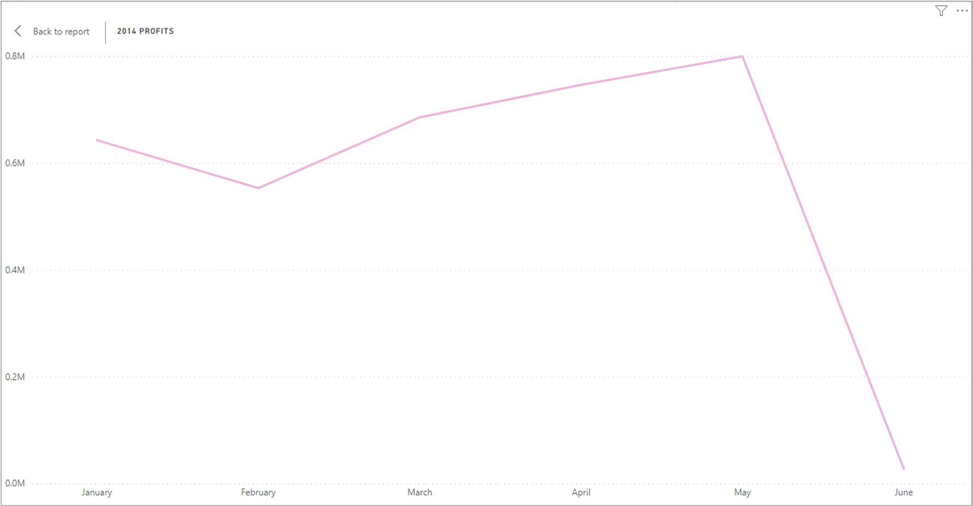
Profits 2013 v 2014
2014 (6 months)
Suffered a massive profit decline in June
2013 (12-months)
Positive correlation
Higher spending at the beginning of each quarter
Summer sales are higher than winter seasons

Slide 14
4. Product subcategory breakdown

Slide 15
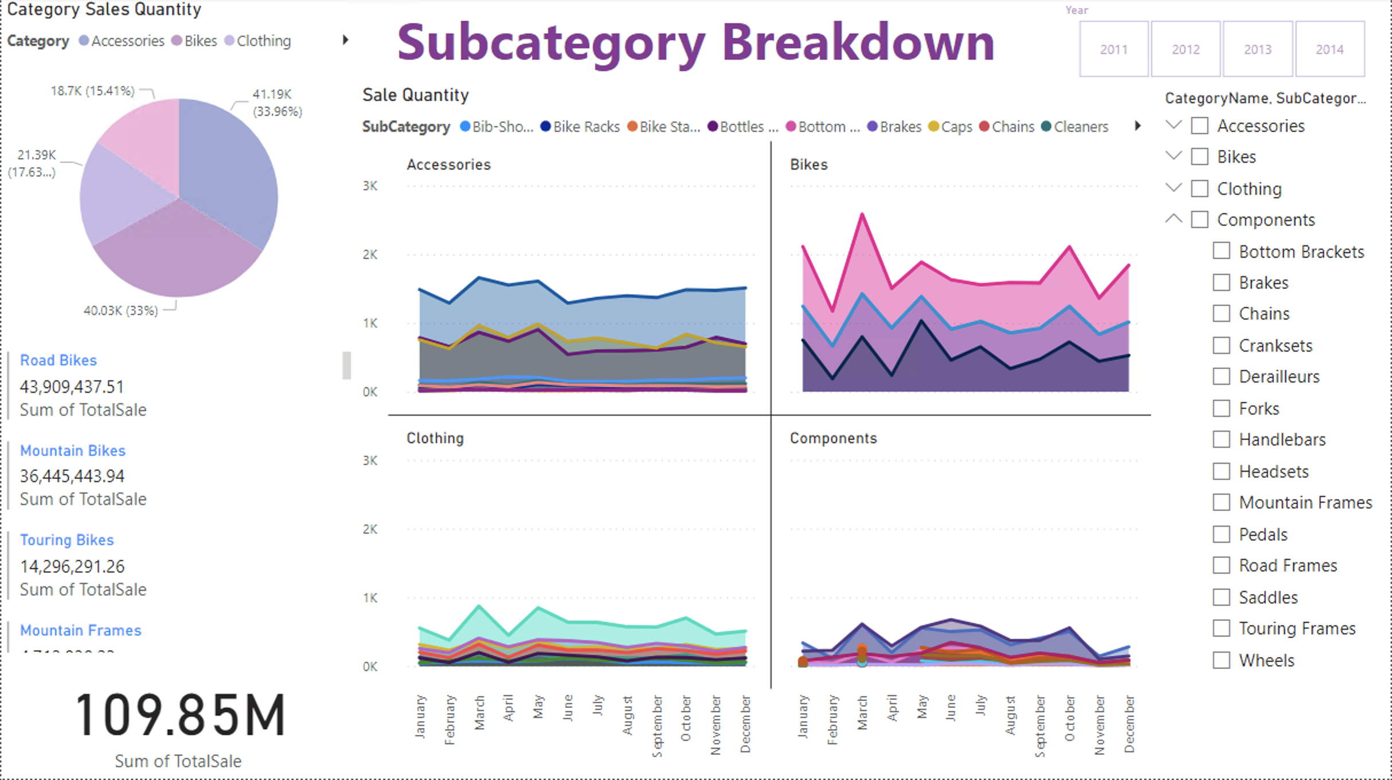
Road bikes and mountains bikes are the most sold subcategory in the bike category

Slide 16
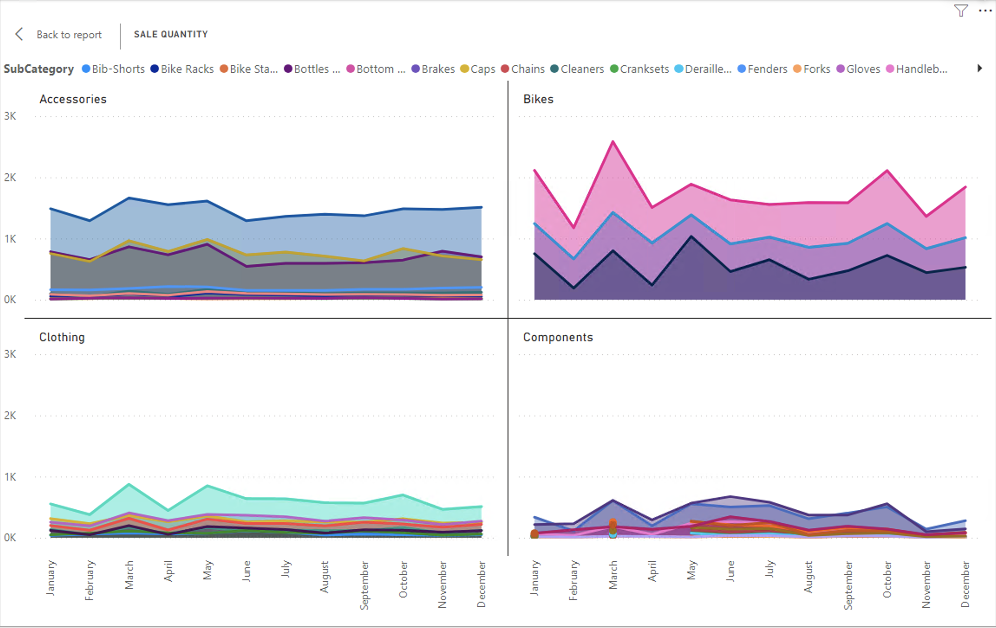
Components continuously sell less in quantity, however accessories and bikes sold remain high YOY.

Slide 17
5. Organisational recommendations

Slide 18
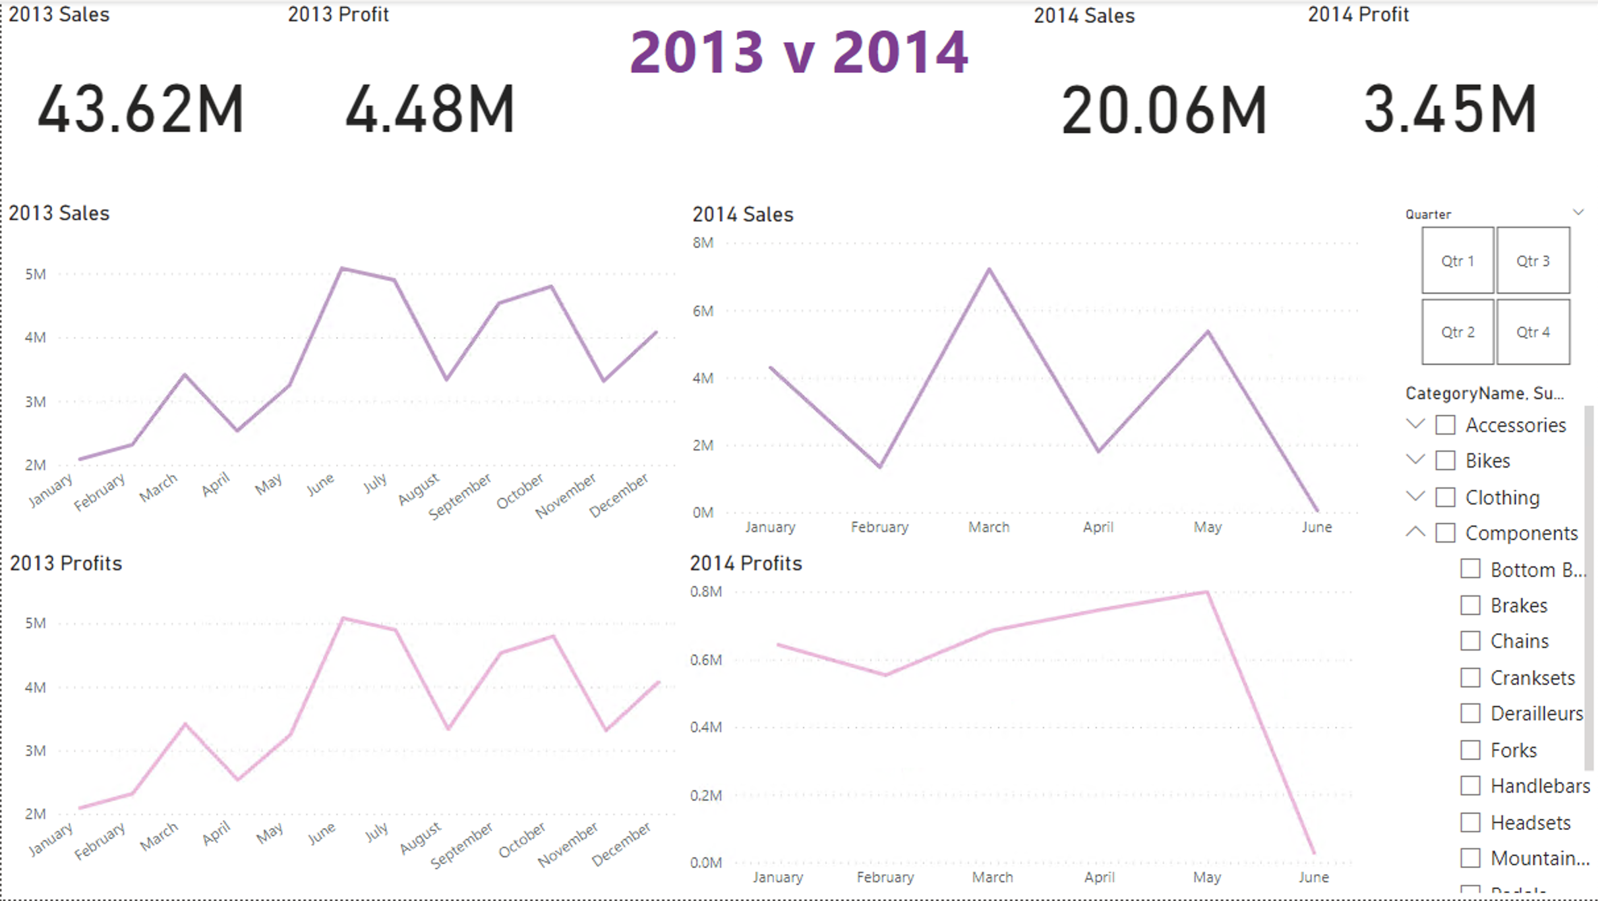

Slide 19
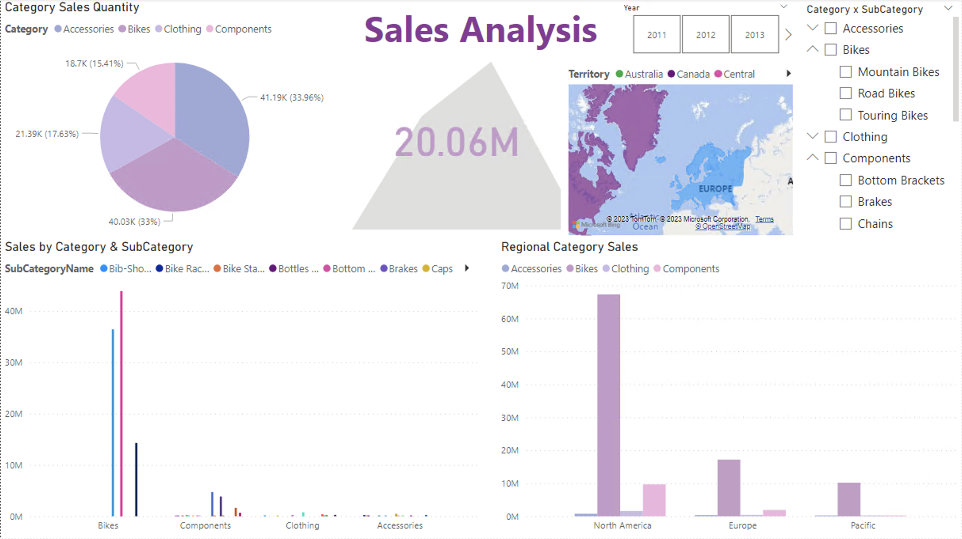

Slide 20
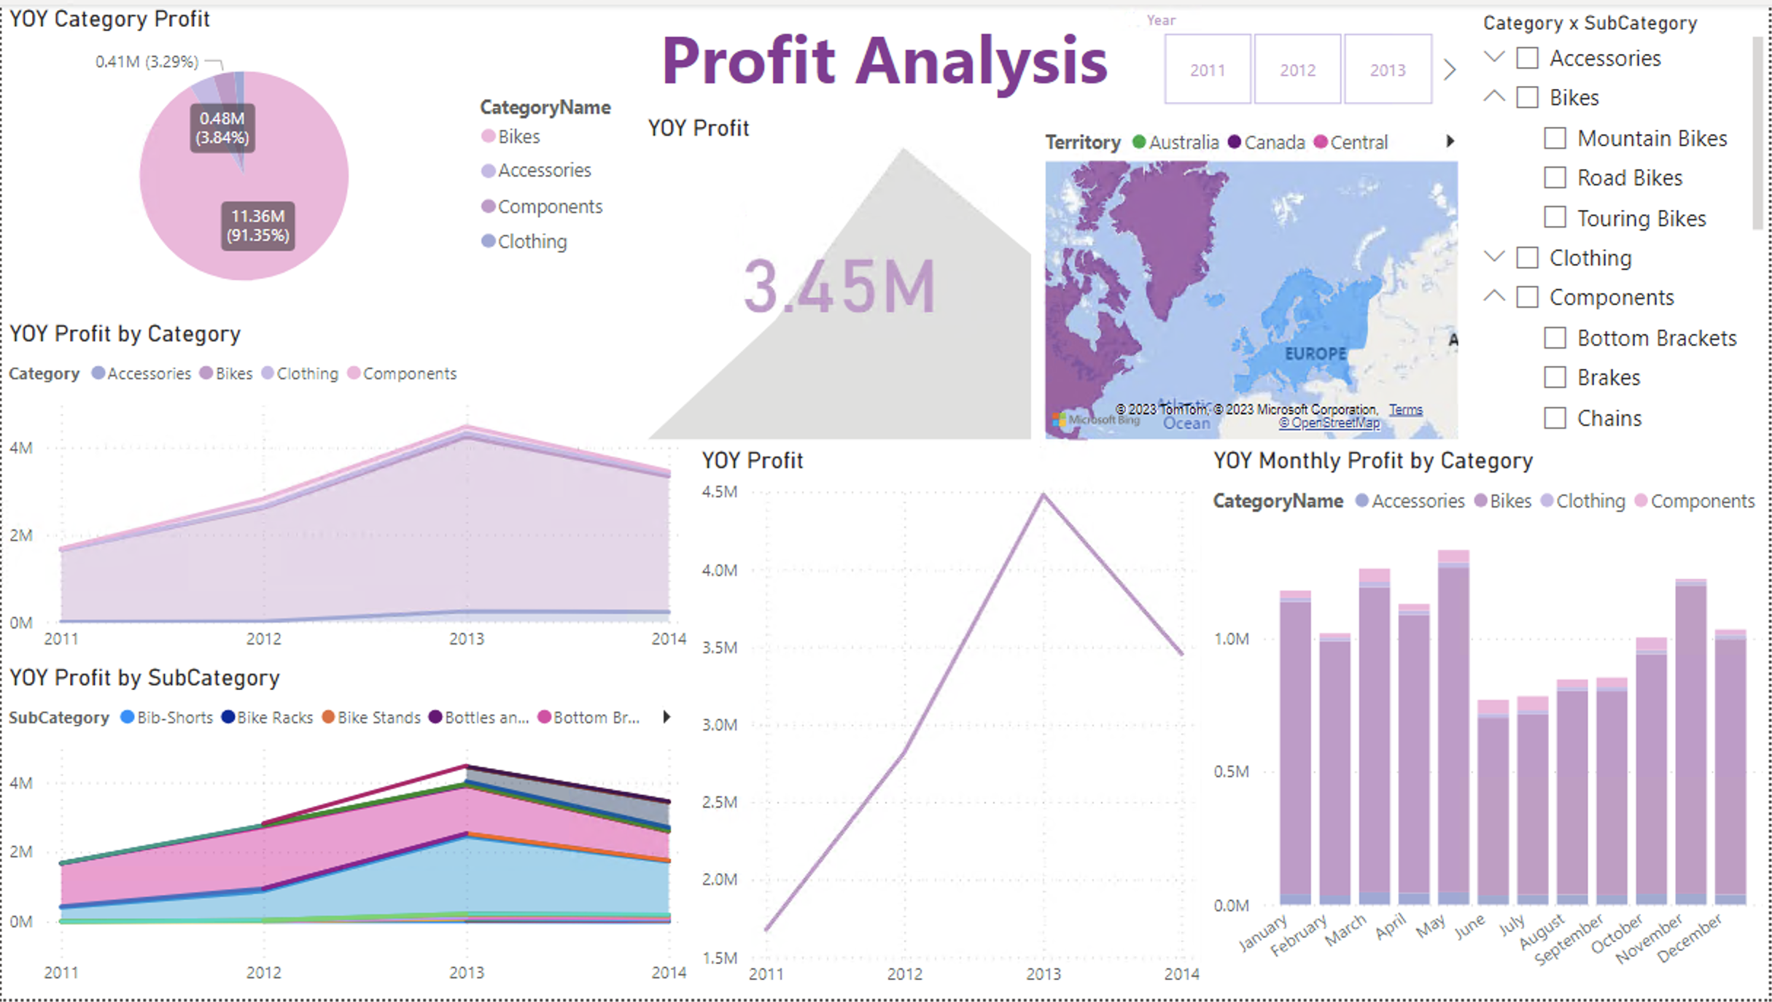

Slide 21
Strategy Tips
Decrease profit margin on subcategory items that aren’t selling as much, to increase sales revenue
Increase customer purchases by introducing discounts and offers during quiet seasons
Slow integration of new subcategory products to monitor sale and profit before introducing more items

